Slide 1


Spring Midterm Presentation
The Two Stooges – Levi Graham and Riley Nichols

Slide 2

Presentation Overview
Project Overview
Project Progress
Project Goals

Slide 3

Project Overview
Go over the idea for the project and the team on the project.

Slide 4
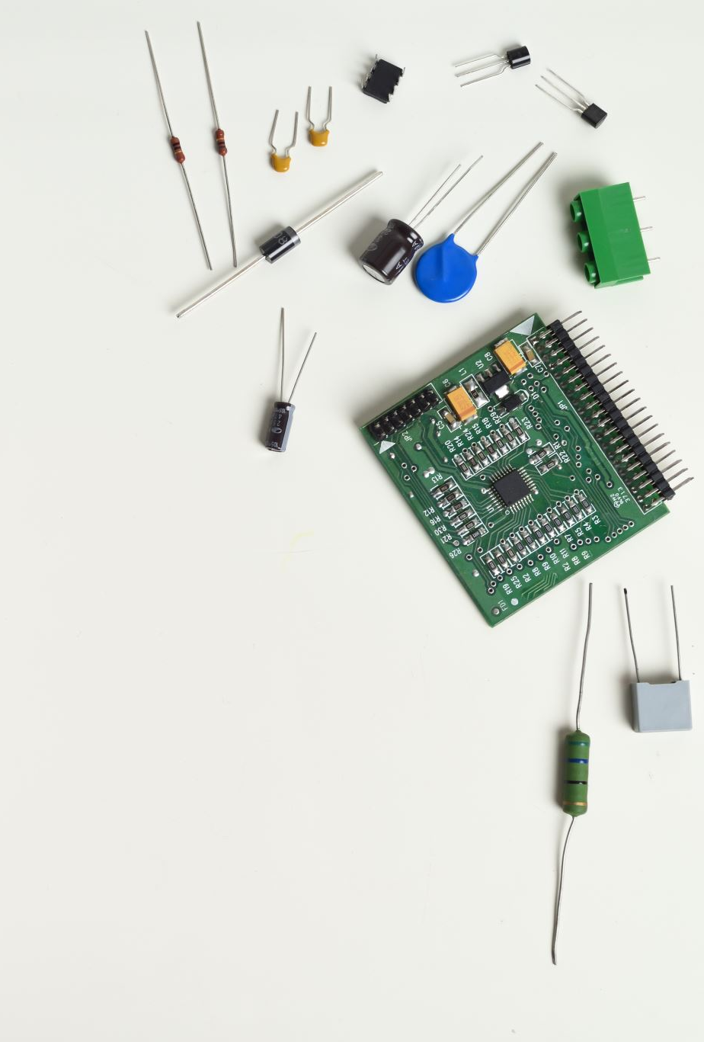
The Team
Levi Graham
Scrum Coach
Technical Lead (Digital Assets and Software)
Riley Nichols
Technical Product Manager
Technical Lead (Hardware)

Slide 5
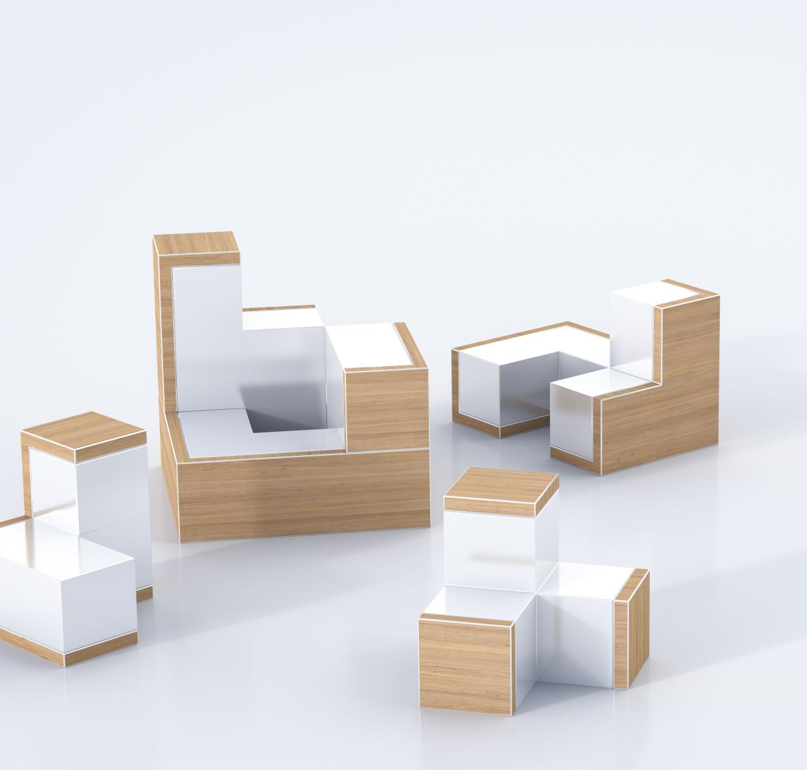
Project Overview
Design and build a haptic glove to be used as meaningful input to a computer.
Create a sandbox environment to demonstrate the glove in use.

Slide 6
Project Progress
Summarize our progress on the project so far.

Slide 7
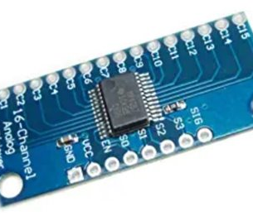
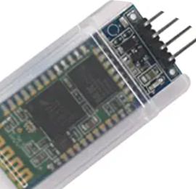
Hardware
Prior to this sprint, the project for this semester primarily tried to implement multiplexers and Bluetooth modules to the haptic glove.
Both systems have been successfully implemented into the program and are working to our standards.

Slide 8
Hardware
We did attempt to have the soldering for the entire circuit done by this point in the project.
Soldering for the PCB board, and the “male” Molex port was finished.
Ran out of time on the sprint to finish soldering on flex sensors and arduino board.

Slide 9
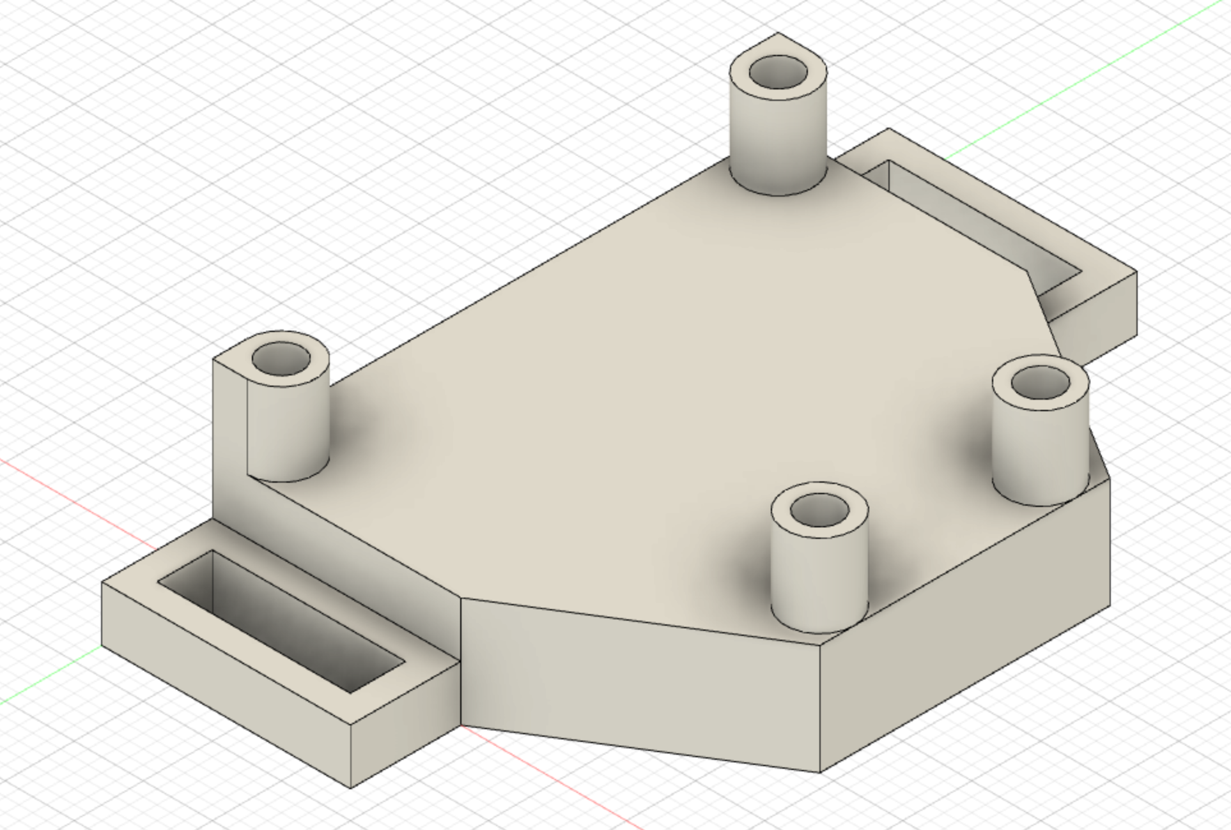
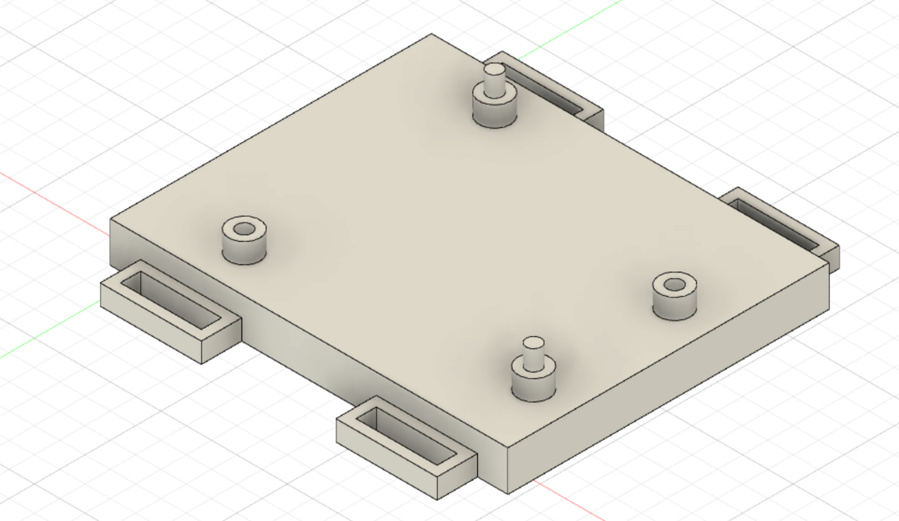
Housing
Modeled most pieces of the housing
Started printing models
Having trouble getting heat-set threads for screwable components

Slide 10

Unity
Created Environment
Added player movement
Added interactions with ball objects

Slide 11
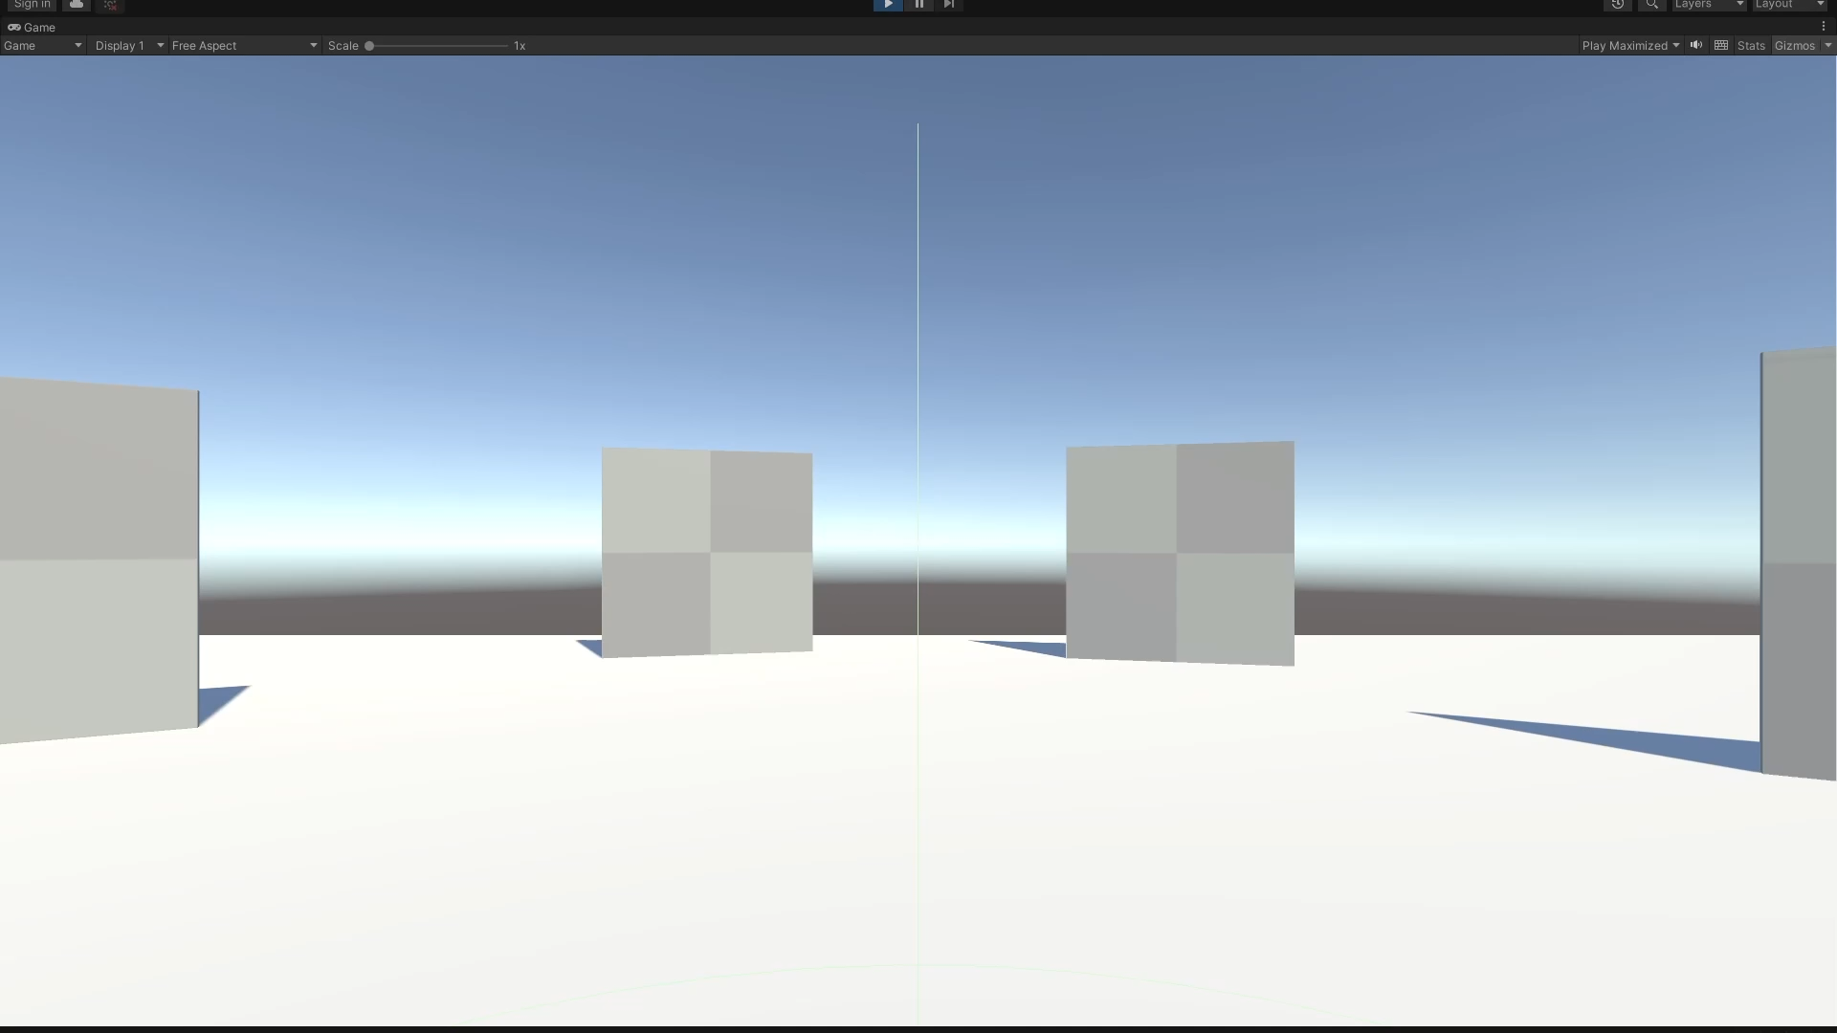
Unity - Demo

Slide 12
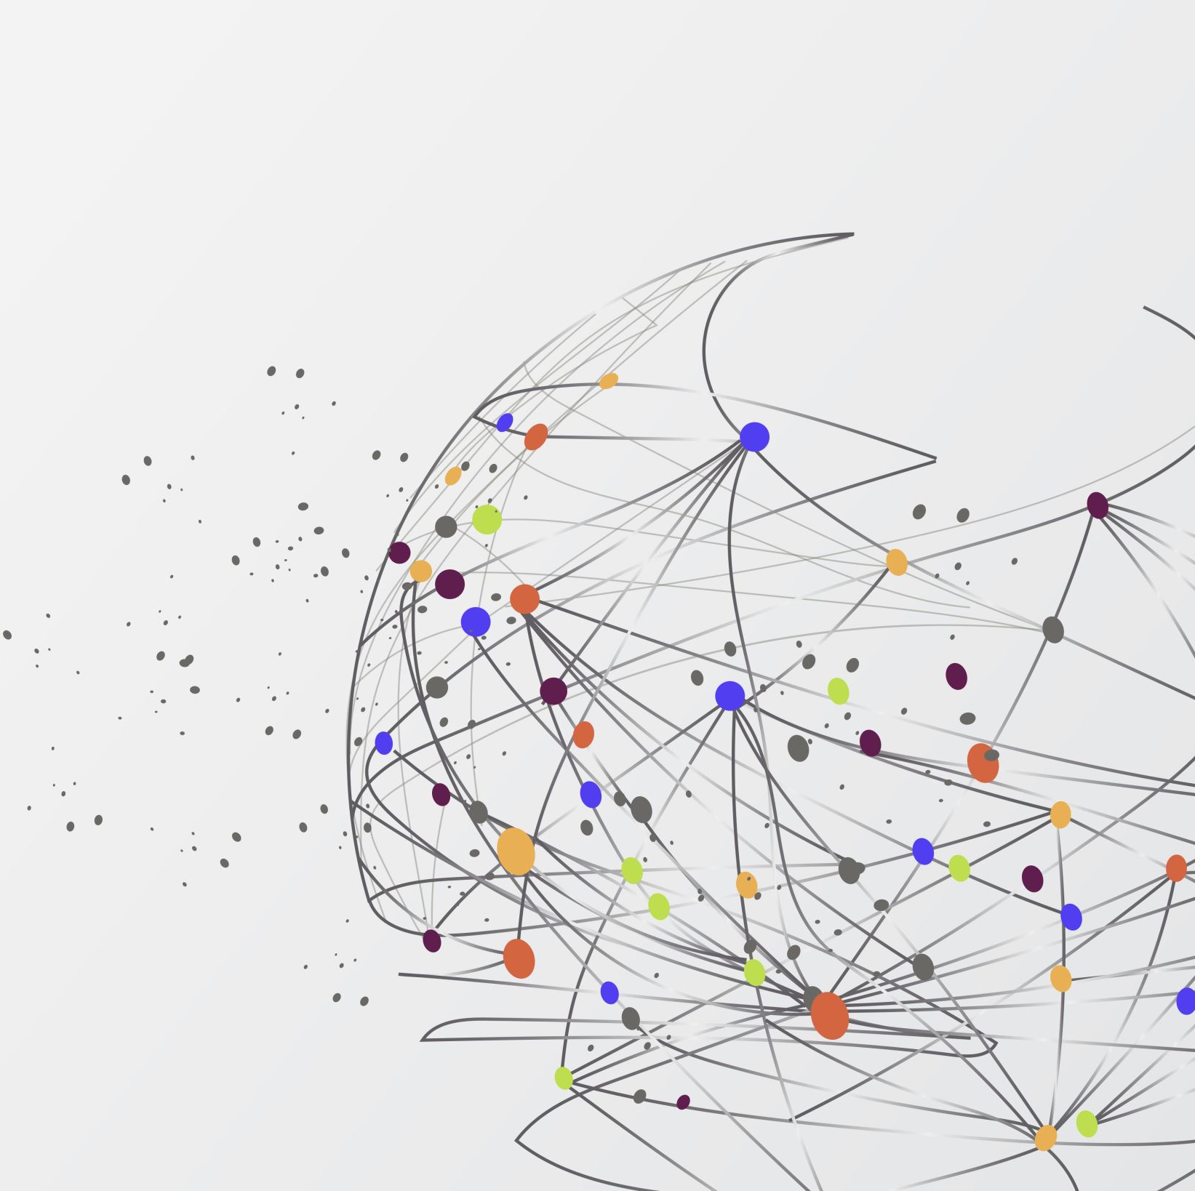
Project Goals
Go over our remaining goals for the project.

Slide 13

Hardware
We plan to finish soldering by next sprint. Soldering has not been complex, just more time consuming than initially intended.
We also will be mapping it out with the hand as to not have excess wiring.
Take the final soldered circuit and fit into housing.

Slide 14
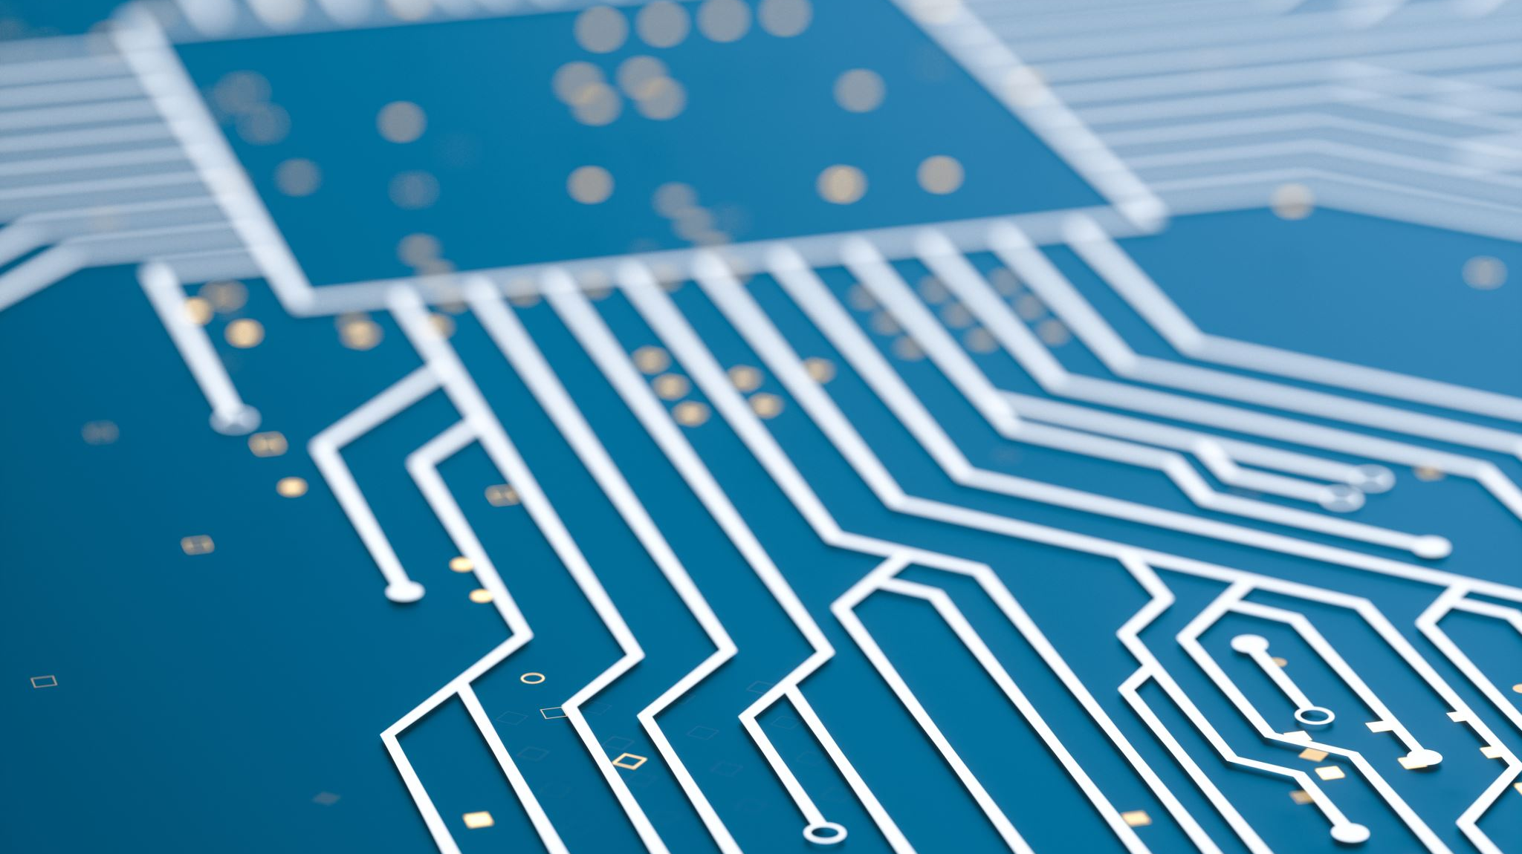
Housing
Finish initial designs
Modify the designs when we find problems
Print out the designs
Integrate parts with electronics
Be able to wear the glove

Slide 15
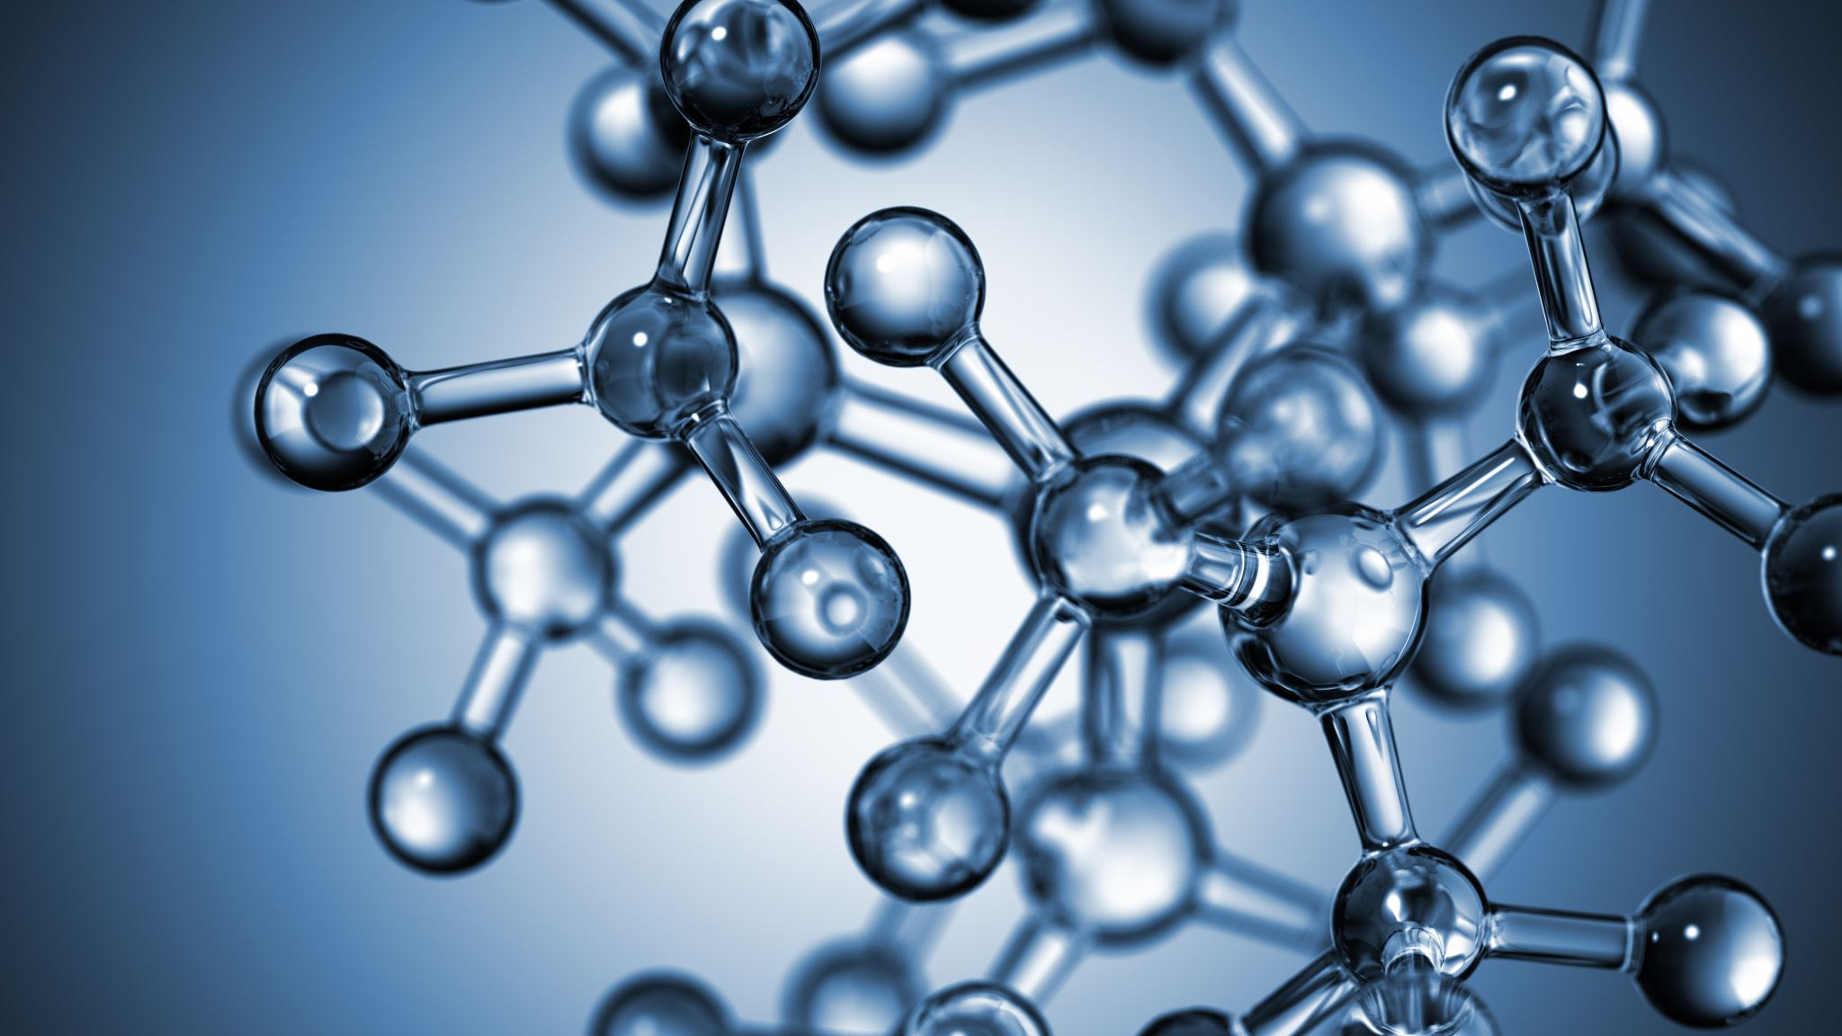
Unity
Add hand model
1
Be able to grab and throw balls at the target
2
Hook up glove as an input device
3

Slide 16

Does anybody have any questions?

